Slide 1
Fundamentals of AC Circuits
Module 2: Fundamentals of AC Circuits

Slide 2


sinusoidal steady-state analysis of Rl, RC & RLC Circuits

Slide 3



overview
$\text{v}\text{(}\text{t}\text{) = }V_{m} \text{sin}\text{(}ω\text{t} \text{−} θ\text{)}$
$f=\frac{1}{T}$
$ω=2πf$
$V_{rms}=\sqrt{\frac{1}{T}\int_{0}^{T}{v^{2}(t) dt}}$
$P_{avg}=\frac{V_{rms}^{2}}{R}$
$I_{rms}=\sqrt{\frac{1}{T}\int_{0}^{T}{i^{2}(t) dt}}$
$P_{avg}=I_{rms}^{2}R$
$V_{rms}=\frac{V_{m}}{\sqrt{2}}$
$I_{rms}=\frac{I_{m}}{\sqrt{2}}$

Slide 4
Phasors
Here, we will see that sinusoidal steady-state analysis is greatly facilitated if the currents and voltages are represented as vectors (called phasors) in the complex-number plane.
We start with a study of convenient methods for adding (or subtracting) sinusoidal waveforms.
We often need to do this in applying Kirchhoff’s voltage law (KVL) or Kirchhoff’s current law (KCL) to ac circuits.
For example, in applying KVL to a network with sinusoidal voltages, we might obtain the expression
v(t) = 10 cos(ωt) + 5 sin(ωt + 60) + 5 cos(ωt + 90)
To obtain the peak value of v(t) and its phase angle, v(t) = Vm cos(ωt + θ)

Slide 5
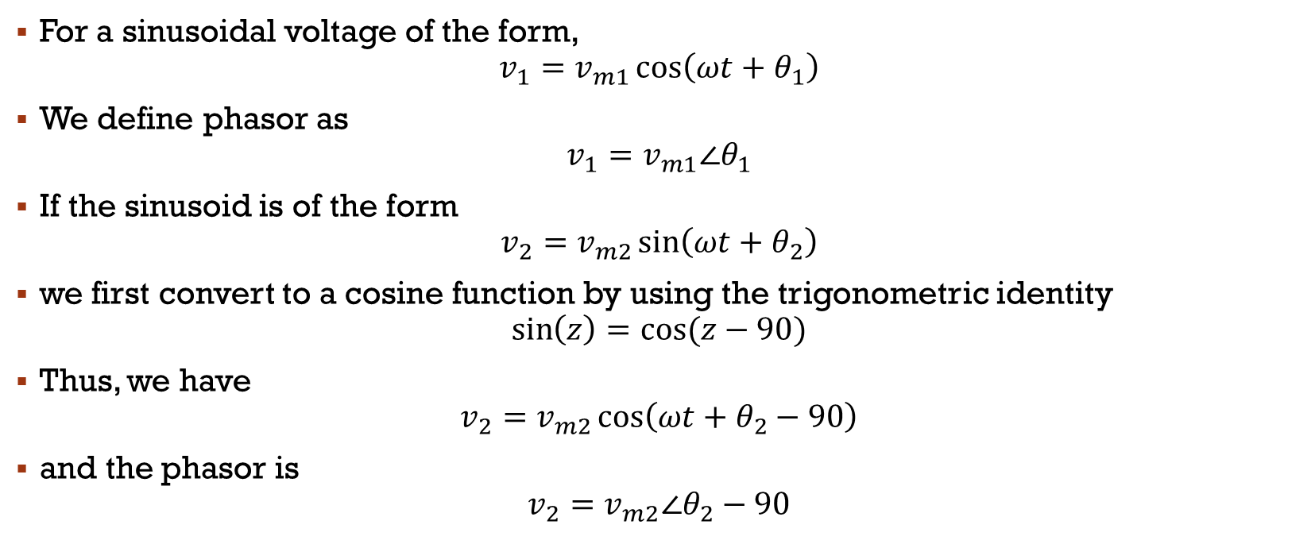
Phasor Definition
For a sinusoidal voltage of the form,
$$v_{1}=v_{m1}\cos\left(ωt+θ_{1}\right)$$
We define phasor as
$$v_{1}=v_{m1}∠θ_{1}$$
If the sinusoid is of the form
$$v_{2}=v_{m2}\sin\left(ωt+θ_{2}\right)$$
we first convert to a cosine function by using the trigonometric identity
$$\sin\left(z\right)=cos⁡(z−90)$$
Thus, we have
$$v_{2}=v_{m2}\cos\left(ωt+θ_{2}−90\right)$$
and the phasor is
$$v_{2}=v_{m2}∠θ_{2}−90$$

Slide 6

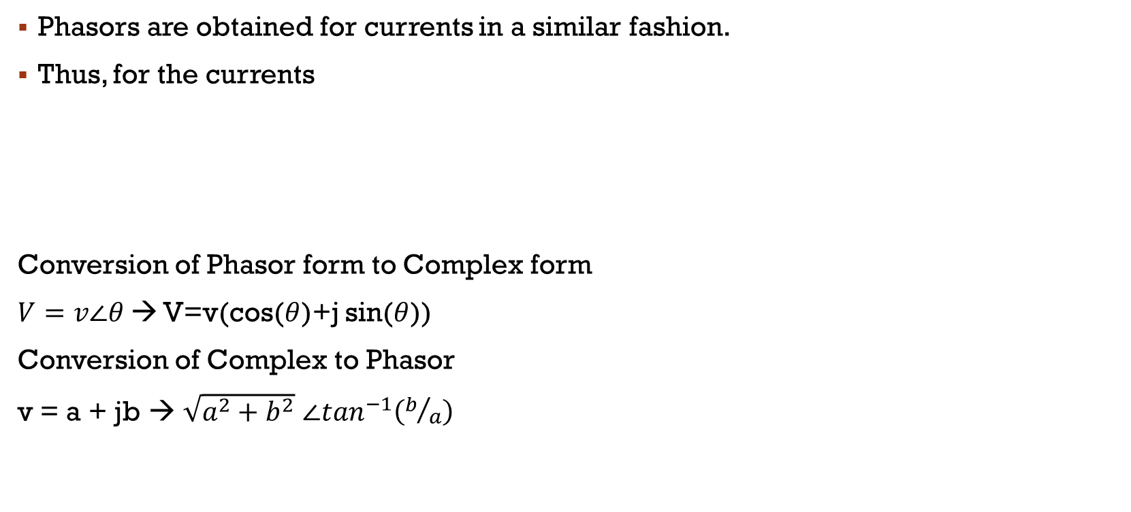
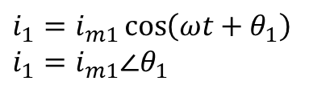
Phasor Definition
Phasors are obtained for currents in a similar fashion.
Thus, for the currents
Conversion of Phasor form to Complex form
$V=v∠θ$ → V=v(cos($θ$)+j sin($θ$))
Conversion of Complex to Phasor
v = a + jb → $\sqrt{a^{2}+b^{2}}$ $∠\tan^{−1}\left(b/a\right)$
$$i_{2}=i_{m2}\sin\left(ωt+θ_{2}\right)$$
$$i_{2}=i_{m2}∠θ_{2}−90$$
$i_{1}=i_{m1}\cos\left(ωt+θ_{1}\right)$
$i_{1}=i_{m1}∠θ_{1}$

Slide 7
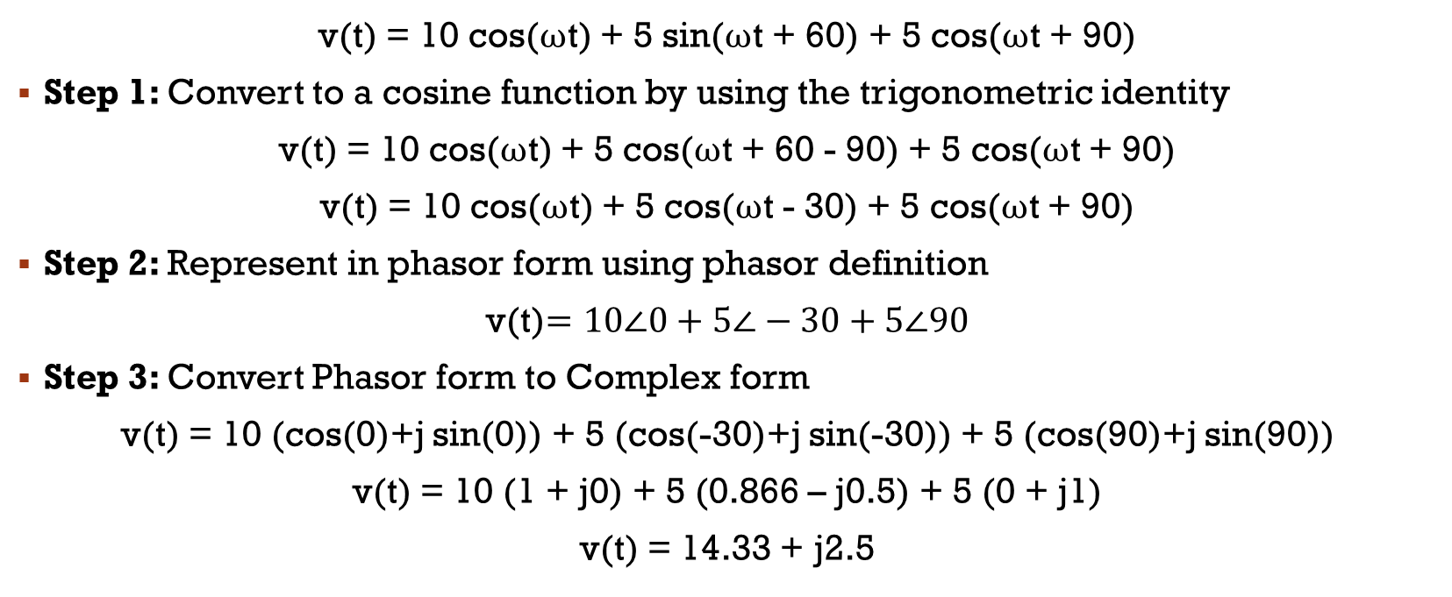
Adding Voltages Using Phasors
v(t) = 10 cos(ωt) + 5 sin(ωt + 60) + 5 cos(ωt + 90)
Step 1: Convert to a cosine function by using the trigonometric identity
v(t) = 10 cos(ωt) + 5 cos(ωt + 60 - 90) + 5 cos(ωt + 90)
v(t) = 10 cos(ωt) + 5 cos(ωt - 30) + 5 cos(ωt + 90)
Step 2: Represent in phasor form using phasor definition
v(t)$=10∠0+5∠−30+5∠90$
Step 3: Convert Phasor form to Complex form
v(t) = 10 (cos(0)+j sin(0)) + 5 (cos(-30)+j sin(-30)) + 5 (cos(90)+j sin(90))
v(t) = 10 (1 + j0) + 5 (0.866 – j0.5) + 5 (0 + j1)
v(t) = 14.33 + j2.5

Slide 8
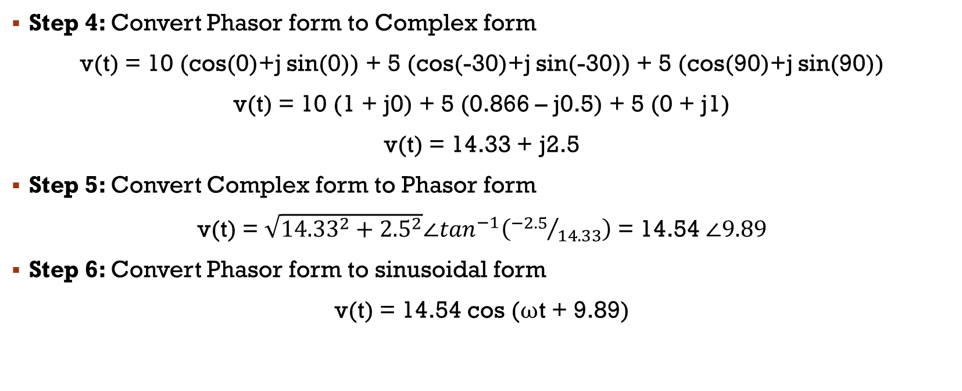
Adding Voltages Using Phasors
Step 4: Convert Phasor form to Complex form
v(t) = 10 (cos(0)+j sin(0)) + 5 (cos(-30)+j sin(-30)) + 5 (cos(90)+j sin(90))
v(t) = 10 (1 + j0) + 5 (0.866 – j0.5) + 5 (0 + j1)
v(t) = 14.33 + j2.5
Step 5: Convert Complex form to Phasor form
v(t) = $\sqrt{{14.33}^{2}+{2.5}^{2}}∠\tan^{−1}\left({−2.5}/{14.33}\right)$ = 14.54 $∠9.89$
Step 6: Convert Phasor form to sinusoidal form
v(t) = 14.54 cos (ωt + 9.89)

Slide 9
Example 1: Using Phasors to Add Sinusoids
Suppose that,
v1(t) = 20 cos(ωt − 45◦)
v2(t) = 10 sin(ωt + 60◦)
Reduce the sum vs(t) = v1(t) + v2(t) to a single term.

Slide 10
Example 2: Reduce the following expressions by using phasors
v1(t) = 10 cos(ωt) + 10 sin(ωt)
i1(t) = 10 cos(ωt + 30◦) + 5 sin(ωt + 30◦)
i2(t) = 20 sin(ωt + 90◦) + 15 cos(ωt − 60◦)

